Slide 1
SEQOHS Standards and Accreditation.
Jean Fisher
SEQOHS Auditor

Slide 2
Introduction
Who has or is working towards standard?
Standards are relevant to all of us.
Many in house services are planning accreditation.
Not just aimed at larger providers.
Sole traders.
Can take 2 years to reach assessment standard.

Slide 3
SEQOHS Accreditation
What is SEQOHS Accreditation ?
It is an independent, clinically led third party assessment of an OHS
Its a fee paying scheme run by the RCP of London on behalf of the Faculty of Occupational Medicine
It assures that an OHS is complaint with SEQOHS standards

Slide 4
SEQOHS Standards
What standards are used?
On 13th January 2010 the SEQOHS standards were launched
There are 13 standards in 6 domains:
Business probity
Information governance
People
Facilities and equipment
Relationships with purchasers
Relationships with workers
NHS Standards

Slide 5
A. Business Probity.
An OHS must conduct its business with integrity.
An OHS must maintain financial propriety.
Examples of suitable evidence….
Documentation of regular contract performance reviews.
Submission of annual account to Companies House.

Slide 6
B. Information Governance.
An OHS must maintain adequate clinical records.
An OHS must implement and comply with systems to protect confidentiality.
Minimum standards …legal and professional practice to be met.
Examples of suitable evidence….
A system in place of clinical audit.
Signed confidentiality agreements.

Slide 7
C. People.
An OHS must ensure that its staff are competent to undertake the duties for which they have been employed.
An OHS must ensure appropriate supervision.
Minimum standards …legal and professional practice to be met.
Examples of suitable evidence….
A list of all staff with a system of checking qualifications in place.
Written procedures with examples of compliance.

Slide 8
D. Facilities and Equipment.
An OHS must conduct its business in facilities that are safe, accessible and appropriate for the services provided.
An OHS must ensure all equipment is safe and appropriate for the services provided.
An OHS must ensure any medicines are handled appropriately.
Examples of suitable evidence….
Records of inspection/disability access etc.
Protocols for inspection and calibration of equipment.
Clinical audit.

Slide 9
E. Relationships with Purchasers.
An OHS must deal fairly with purchasers.
An OHS must be customer focused.
Examples of suitable evidence..
Service level agreements.
Customer satisfaction questionnaires.
Records of contract meetings with clients.

Slide 10
F. Relationship with Workers.
An OHS must ensure workers are treated fairly.
An OHS must respect and involve workers.
Examples of suitable evidence..
Copies of leaflets which define workers rights.
Complaints procedure.
Employee leaflets.

Slide 11
G. NHS Standards.
An OHS must be able to deliver each of the six NHS core services to NHS customers.
An OHS must review services with the NHS customer at least six monthly.
Prescriptive evidence..
Notes of review meetings.
Evidence of delivery of each of the six core services.
(Prevention, timely Intervention, rehabilitation, health assessments, health promotion, teaching and training)

Slide 12
The value of accreditation.
Raises the profile and importance of OHS
Ensures that OHS meet the standards through continuous improvement.
Professionally led assessment ensures consideration is given to challenges and new developments
Acknowledges the hard work of OH teams
With this accreditation process the aim is to pass first time

Slide 13
To pass SEQOHS Accreditation
An OHS must:
Provide clear evidence that they have met all of the SEQOHS Standards.
Must maintain the SEQOHS Standards and provide annual updates.
The level of assessment will reflect the type of service provided

Slide 14
Pathway - Stage One
OH Service registers to complete self-assessment
OH service completes self assessment upload & evidence
Online System automates a rating for each standard according to the Traffic light system
Guidance and set up with Online System by the SEQOHS Office
OH Service reviews results and plans improvements
Access to action planning and KMS - improvement tools.

Slide 15
Training and support
A system of support has been developed to enable services to achieve accreditation.
Support is provided through a number of mechanisms:
Direct training
Knowledge Management Systems
The SEQOHS Office

Slide 16
Stage Two
Agree date for SEQOHS Accreditation
Access to training, How to pass SEQOHS Accreditation Seminars
SEQOHS Assessors review evidence prior to visit
Review checklist, provide feedback to the OH Service and add comments for fellow assessors
SEQOHS Assessors Conduct Assessment and prepare a report
Assessors carry out assessment and complete their report online with their findings and recommendations

Slide 17
SEQOHS Assessors’
Clinical Lead (Doctor, Nurse, Manager)
Evidence validation
Finalisation of report
Central audit support
Audit assessment support
Notes:
17

Slide 18
The Process
Firstly self-assessment against the standards
Accreditation - submission of data/evidence
Remote assessment or site assessment
QA Board adjudication
Sign off for Accreditation
Annual renewal of Accreditation
5 yearly Reaccreditation

Slide 19
Home Page
The self assessment is supported
By a web tool and leads to Accreditation.

Slide 20
Self-Assessment
OH Services complete readiness Assessment option to complete the Self-assessment.

Slide 21
Services provided
OH Services should tick for each of the services that they provide. This drives your SEQOHS Assessment.

Slide 22
Completing Self-assessment
1. Select reporting period from this drop down menu.
2. Answer Yes, No or N/A
NOTE: Only OH Services with evidence should select Yes.
3. Use information icons to reveal evidence requirements.

Slide 23
Unrequired SEQOHS Standards
Greyed out items are not applicable to the OH Service based on the services selected earlier in the process.

Slide 24
Evidence upload Information
Click on the information icon to see evidence requirements

Slide 25
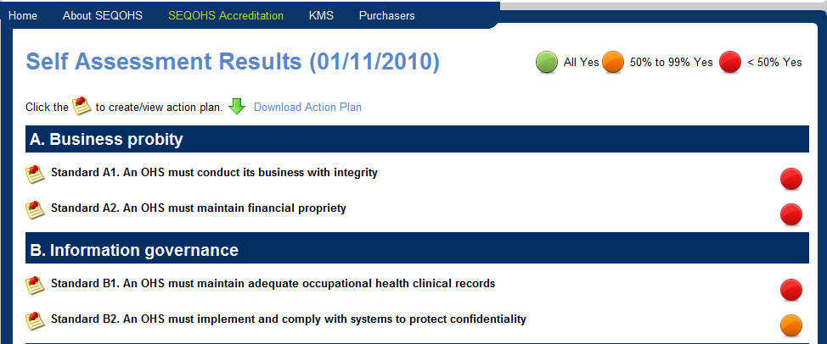
View Results
Results show progress against standards
Traffic light system (red, amber, green)

Slide 26
Annual accreditation renewal
Annual renewal via document and information submission
Annual ‘report card’
Five yearly Reaccreditation Assessment
Provides Assurance
Assesses against agreed standards
Strengthens Services
Identifies areas for improvement
Recognise strengths

Slide 27
Summary
SEQOHS applies to us all.
Minimum standards of OH delivery.
Acknowledges hard work of OH teams.
Develops good OH practice.
Approx 75 services accredited and over 200 registered.
Accreditation Handbook available.

